Slide 1
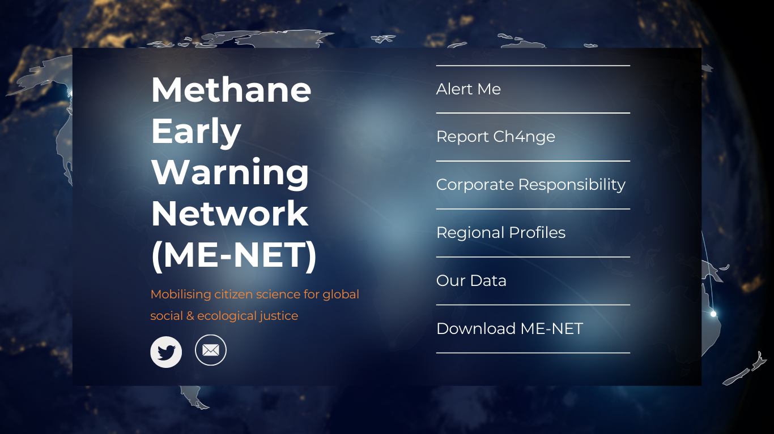
Methane Early Warning Network (ME-NET) Our Vision & purpose: Championing social and ecological justice by improving understanding of the relationship between methane and health outcomes, encouraging companies to reduce their footprint for climate change mitigation, increasing the visibility of ‘hidden’ voices, and improving understanding of service access inequalities.
Team O₂H
One (Environmental & Mental) Health
Develop a dashboard for tracking the effects of methane on health

Slide 2


John ‘reality check’ Atanbori
Machine learning, dashboard development
reality-truthing over-enthusiastic colleagues
Hazza ‘it’s a wrap!’ Moore
Concept development, data synthesis
Get stuff done and dusted
Niro ‘the bridge’ Siriwardena
All things public health, clinical insight
Bridges the patient-clinician-scientist gap
Ed ‘the Earther’ Hanna
Climate change expert, data analyst
Brings us down to Earth
Mark ‘the integrator’ Gussy
All things rural & coastal health, systems thinking
Brings together all the loose threads

Slide 3
THE CHALLENGE
What we know:
Methane has known indirect impacts on health via the production of ground level ozone;
Methane contributes to global warming which also increases ground level ozone.
What we don’t know:
Other than acute toxicity from high on-site concentrations, we don’t really understand the more direct impacts of atmospheric methane on health outcomes;
Research questions:
Can we quantify the impacts of methane from super-emitters on respiratory and mental health outcomes via the production of ozone for the purpose of early warning?;
What about direct impacts of only methane? Are we missing something?

Slide 4
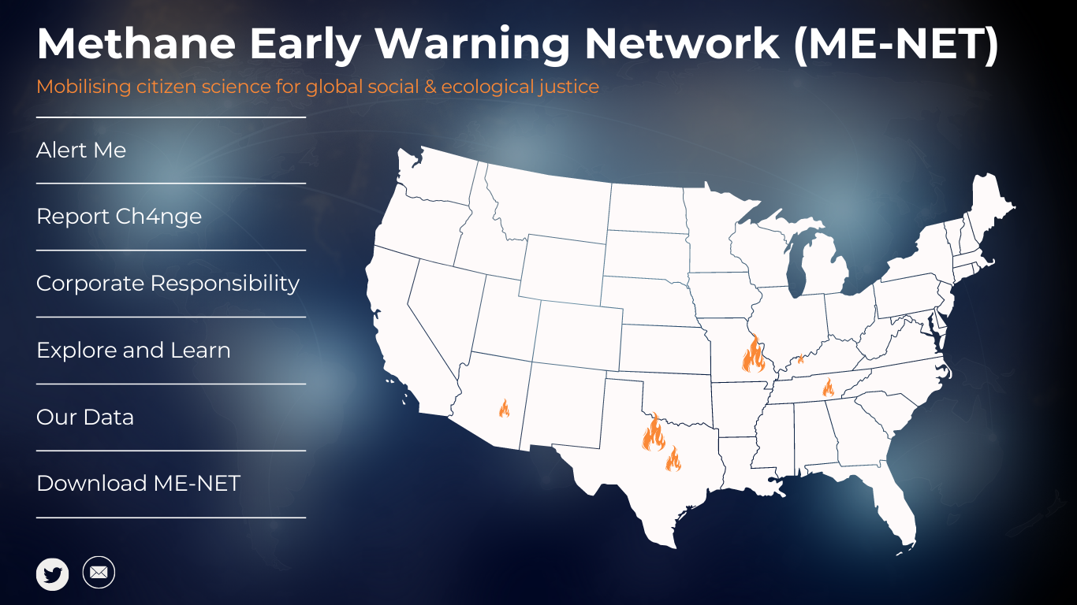

Slide 5
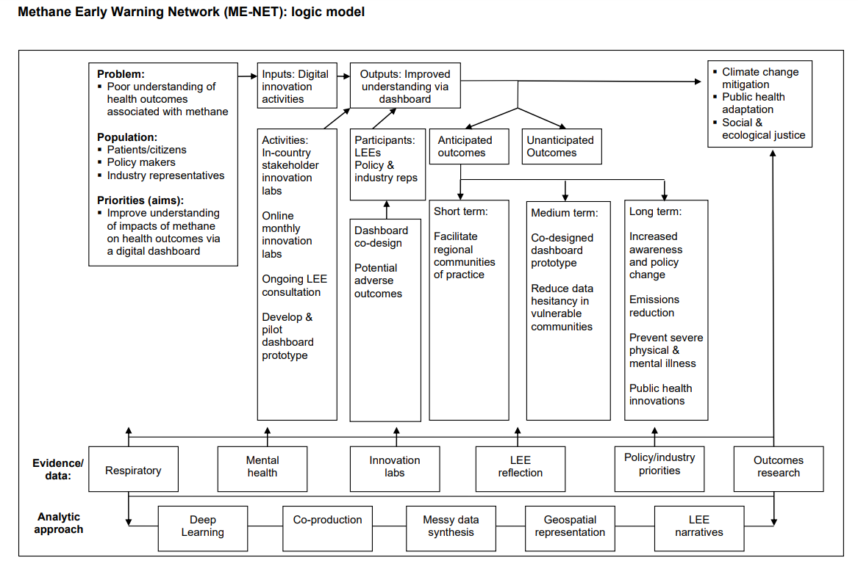
Methane early warning network (ME-NET): logic model

Slide 7
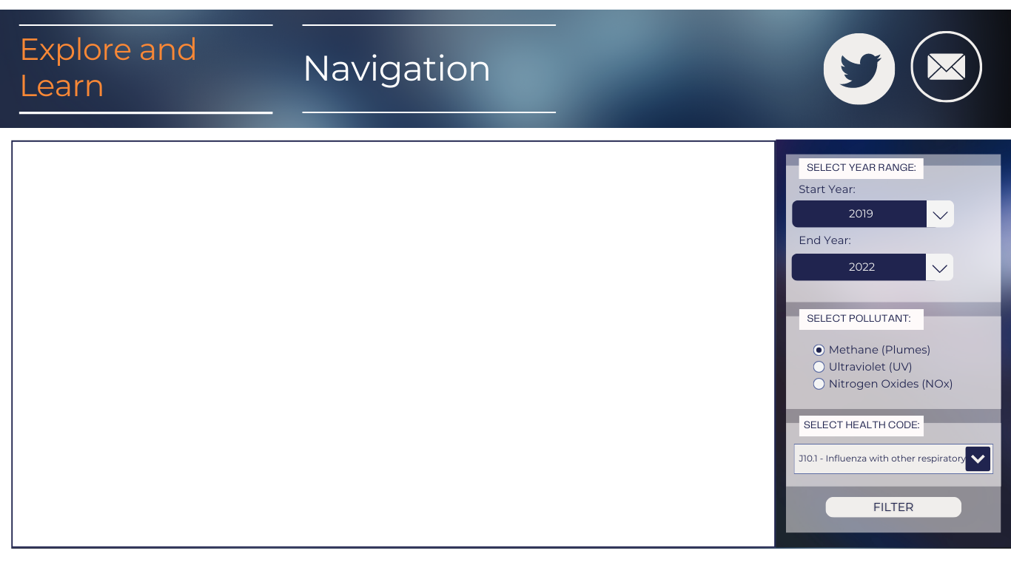
Use the health filters to explore associations between proxy ‘state level’ methane concentrations based on plumes and respiratory health outcomes:
Mortality from respiratory conditions differentiating between ‘viral respiratory conditions’, ‘asthma’, & ‘chronic conditions’;
Implications:
Short-term: prepare COVID-19 wards, prepare for aging communities with chronic condition flare-ups in retirement homes & assisted living.
Long-term: establish- ‘thresholds’ for pollution concentrations linked to acute health outcomes.

Slide 8
Use the health filters to explore associations between proxy ‘state level’ methane concentrations based on plumes and mental health outcomes:
Proportion of patients using mental health services reporting e.g., anxiety/depression (high prevalence), schizophrenia/psychosis (high severity);
Implications: preparing services for mental health emergencies with varying behavioural characteristics from mild to severe, requiring different primary/emergency care services.

Slide 9
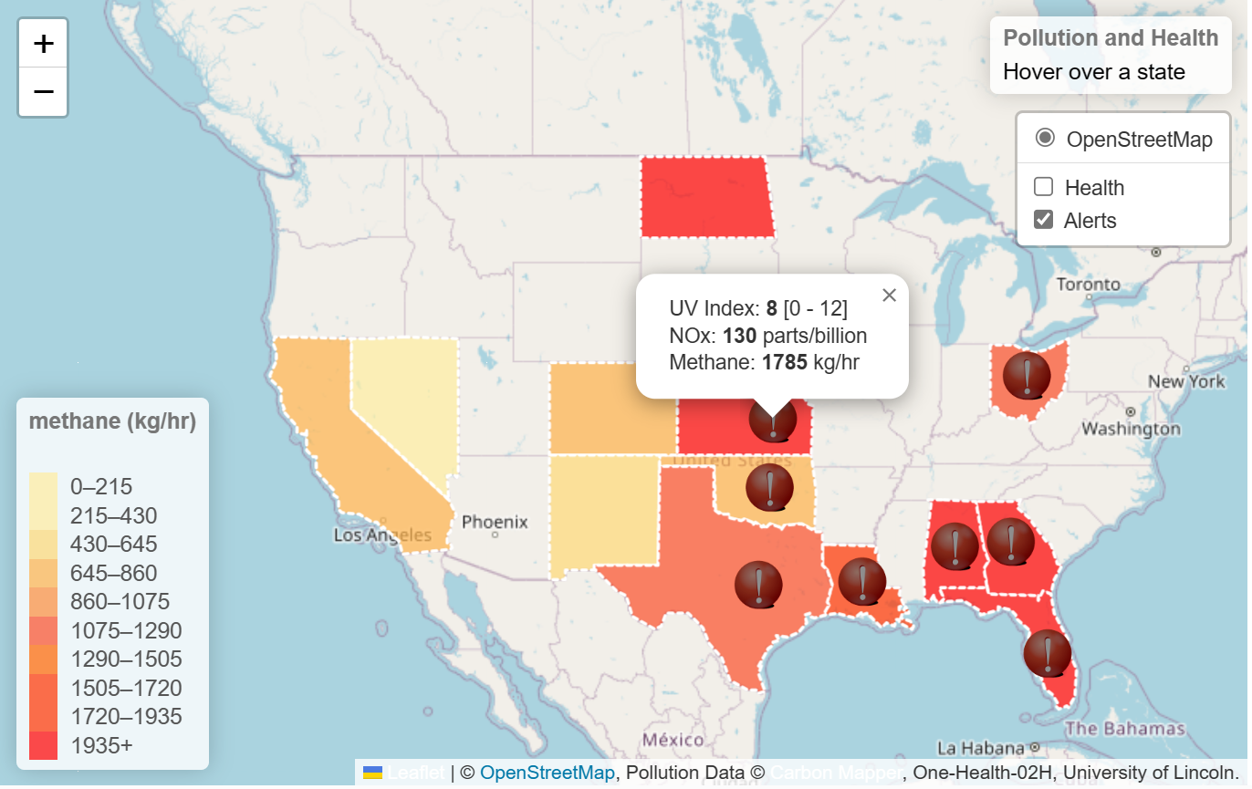
*Colourblind ‘safe’ scheme selected via: https://colorbrewer2.org/#type=sequential&scheme=BuGn&n=3
http://localhost/One-Health-02H

Slide 11
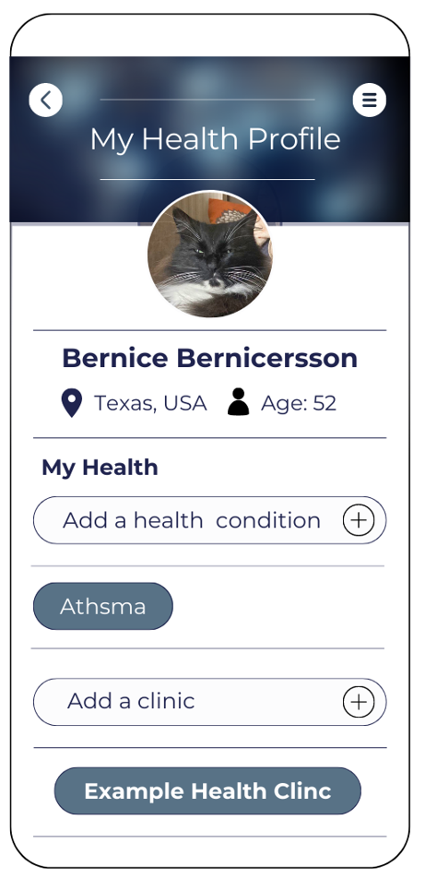
ALERT ME
Bernice enters their health information and location;
They have reported a condition which could evolve into an acute condition on bar ozone days;
On a moderate/high ozone risk day in their regions they receive an alert;
= prevent escalation of conditions to emergencies

Slide 12
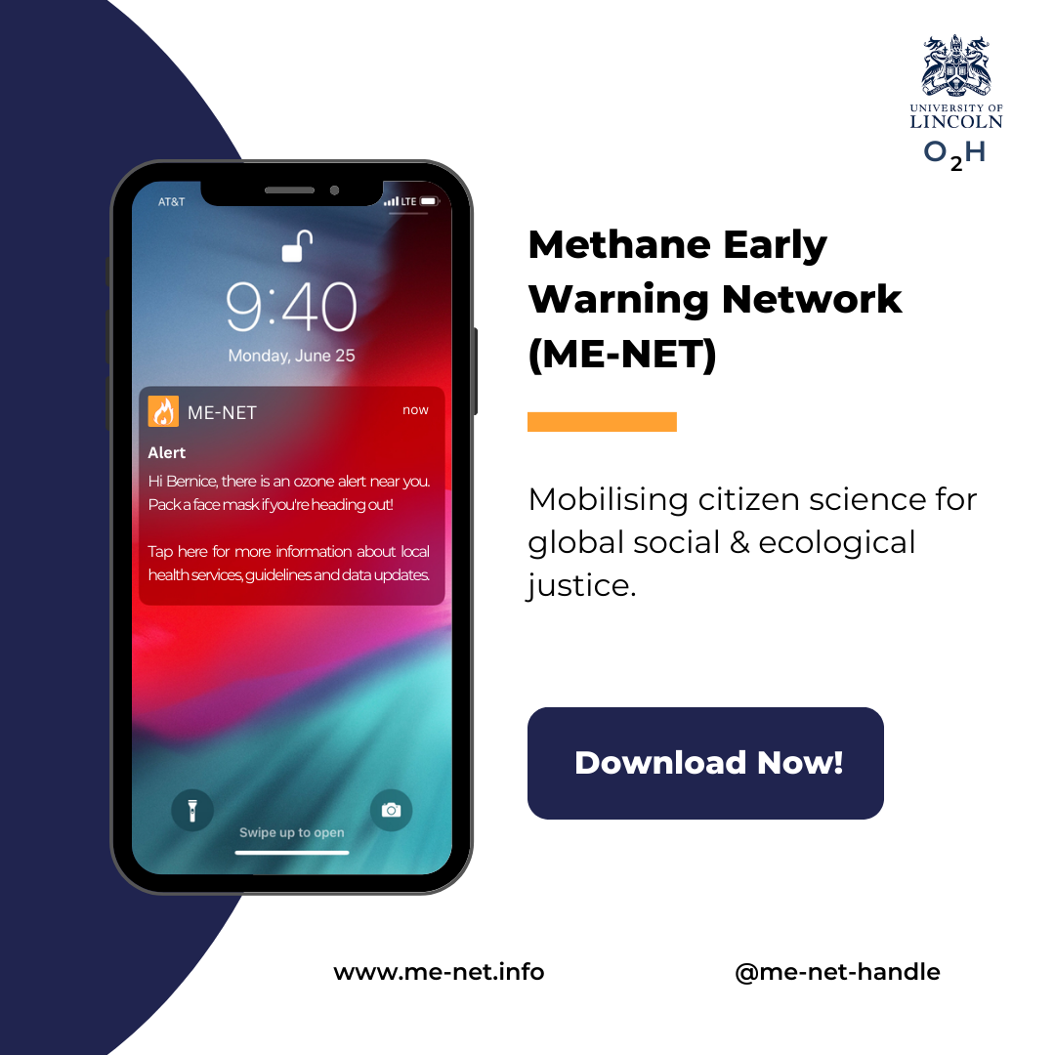
“Hi Bernice, there is an ozone alert near you, pack a face mask if you are heading out!
Tap here for more information about local health services, guidelines and data updates.”

Slide 13
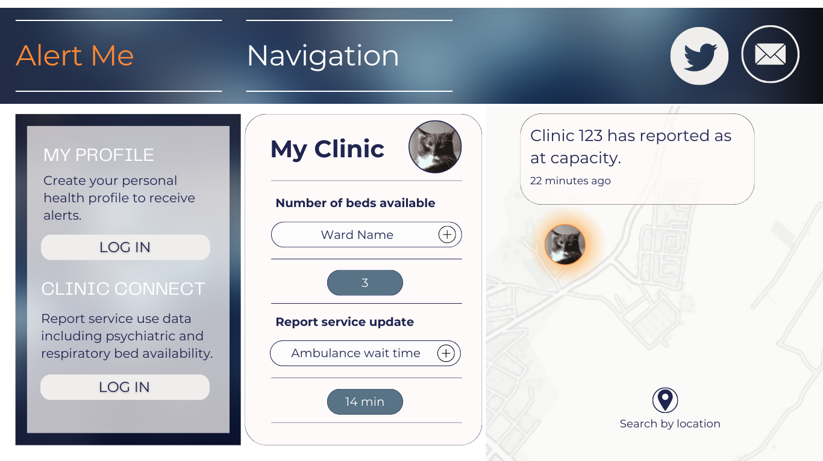
CLINIC CONNECT
Bernice

Slide 15
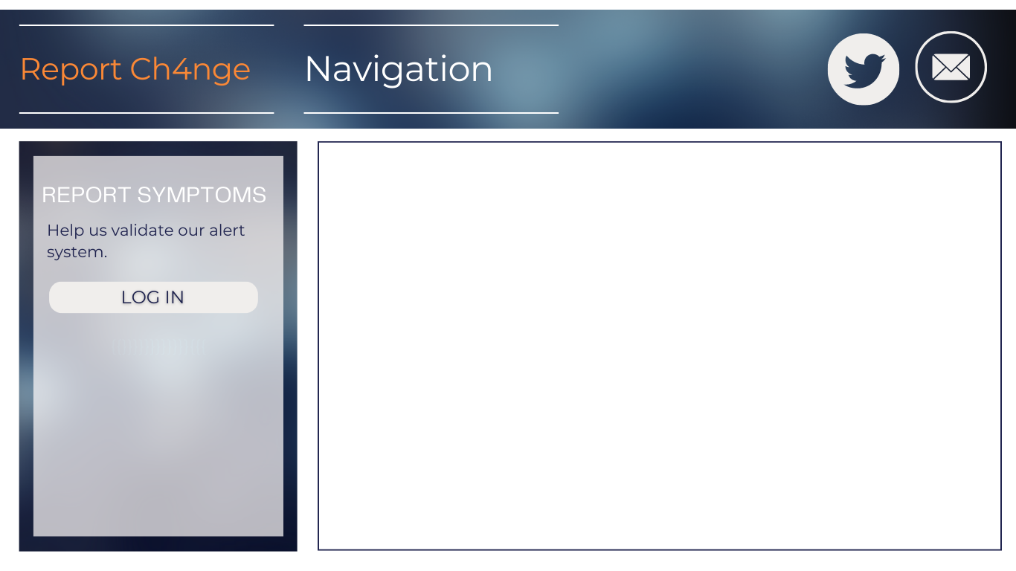
CITIZEN SCIENCE INTERFACE
Health symptoms:
Tell us your symptoms Bernice!
Did you access a health service? If no, why not?
Environmental monitoring:
On-ground CH_{4/}O₃
Report a CH₄

Slide 16
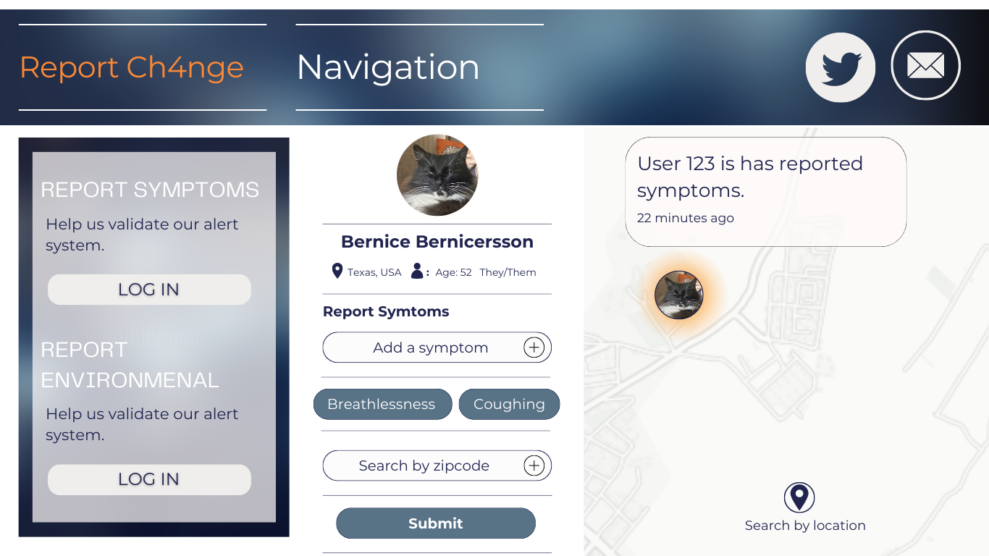

Slide 18
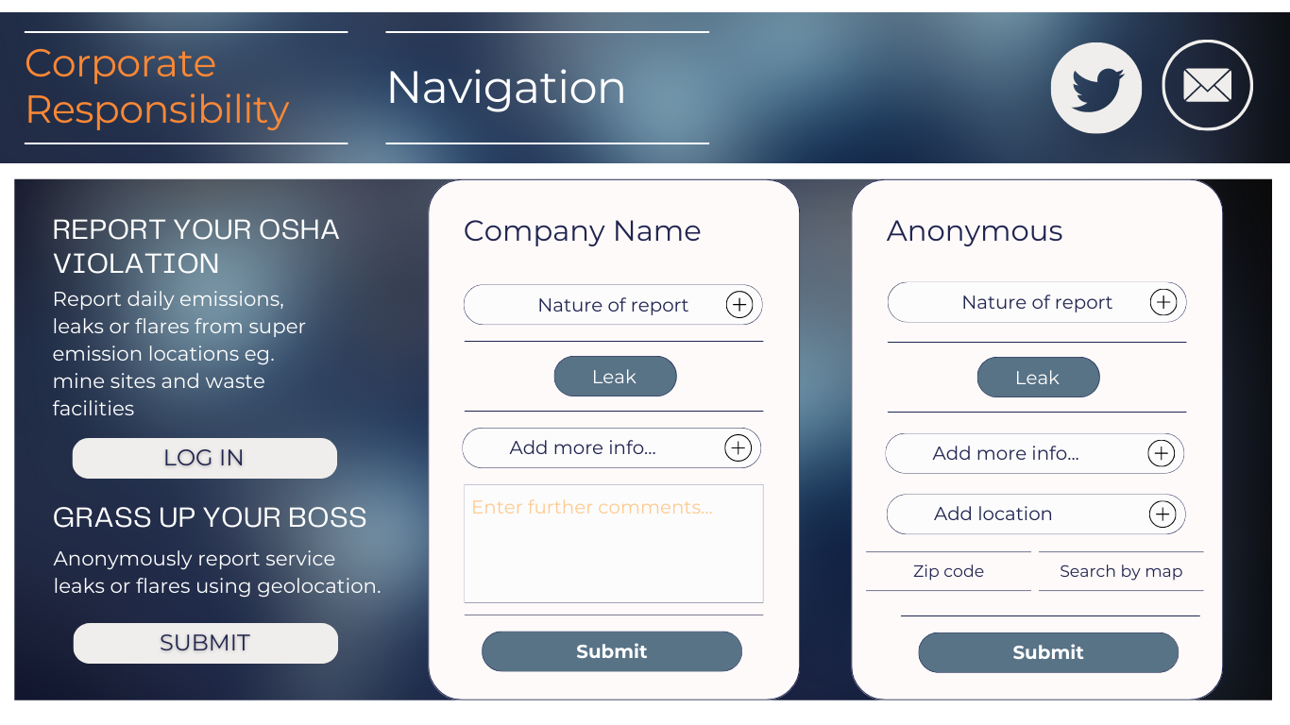
Opt into Tweet Our Responsible Reporting!

Slide 20
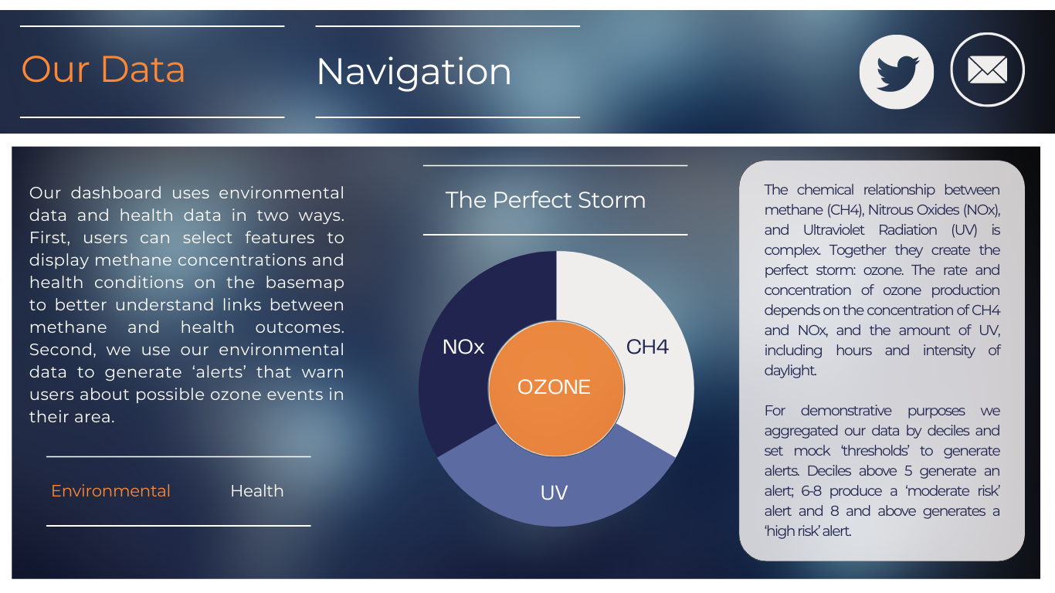
OUR DATA

Slide 21
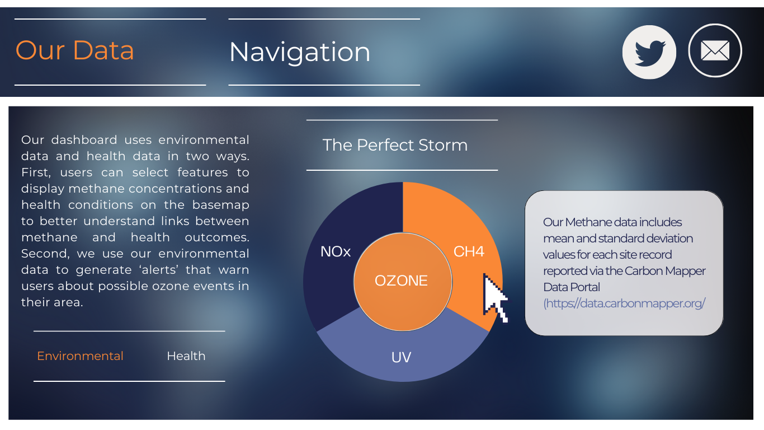
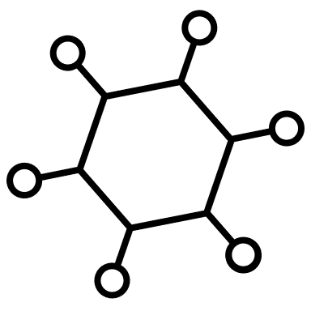
OUR DATA

Slide 22
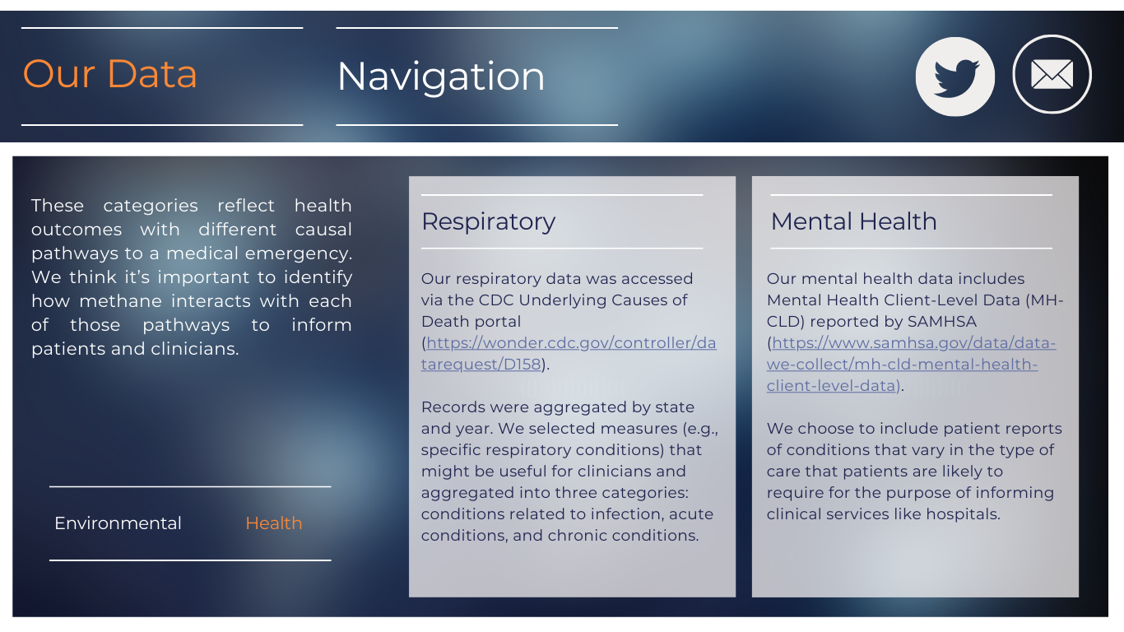
OUR DATA

Slide 23

How does ME-NET present complex data (and their relationships) in a way that can be understood by stakeholders without ‘dumbing down’?
Showing associations between factors in the model in a simplified yet accurate way e.g., schematics for the ‘Our data’ function;
Colour and schemes that reflect global standards for ‘better’ and ‘worse’ e.g., a red to yellow scale where darker shades reflect worse environmental and health outcomes via ‘Explore and learn’ = promoting inclusivity
Universally recognisable symbols like exclamation marks to represent ‘alerts’.

Slide 24
How does ME-NET present complex data (and their relationships) in a way that can be understood by stakeholders without ‘dumbing down’?
The ‘Explore and learn’ function that includes easy to use drop-down selection features allowing users to overlay methane concentration with alerts and health outcomes;
Visual representation that is intuitive, relatable, and meaningful without requiring expert knowledge about climate science, chemical compounds, or medical conditions e.g., spatially convergent variables

Slide 25
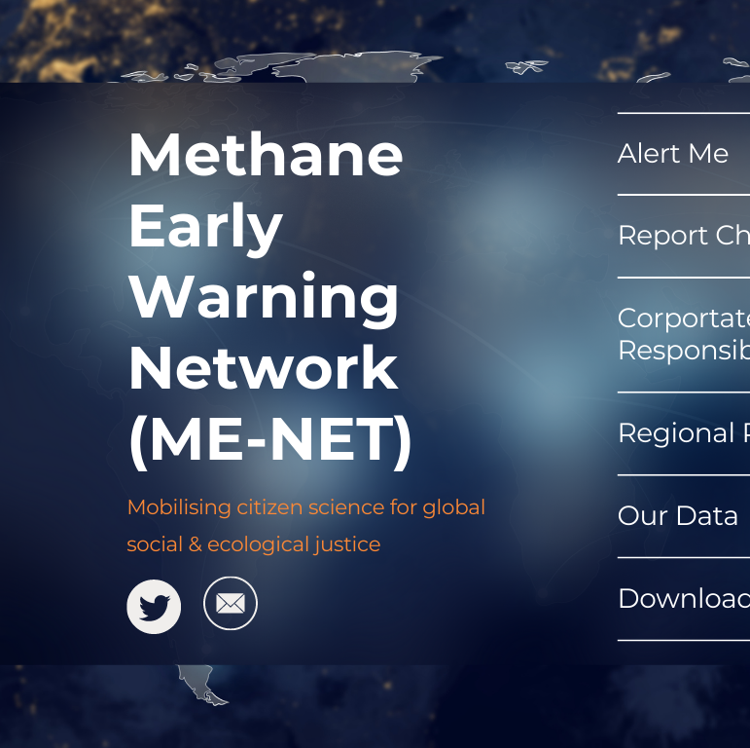
Ensuring ME-NET is accessible, useable, and sustainable with safely shared and creditable data
Accessible, useable & sustainable:
Mobile and dashboard design for usability following Nielsen’s principles of usability heuristics
Useability & accessibility through iterative co-design with public and patient involvement and engagement groups, lived experience experts, corporate stakeholders and our ethical app development team e.g., designing the interface in-country
Sustainability by harnessing open-source data and citizen science to improve model accuracy

Slide 26
Ensuring ME-NET is accessible, useable, and sustainable with safely shared and creditable data
Safely shared and creditable:
Safely shared citizen/patient data will be encrypted and anonymised e.g., geocoding at scale that de-identifies actual location
Anonymity function for corporate users to protect employees
Utilises public access environmental and health data from credible sources (e.g., CDC), links users to data sources
Geocoding & photograph required for uploading anonymous real-time on-ground readings – traffic light system to let users know if the date has been validated e.g., ‘red’ if uploaded with no evidence, ‘orange’ for evidence upload, ‘green’ for uploaded evidence substantiated through citizen science
Diversity of data to promote credibility & inclusivity

Slide 27
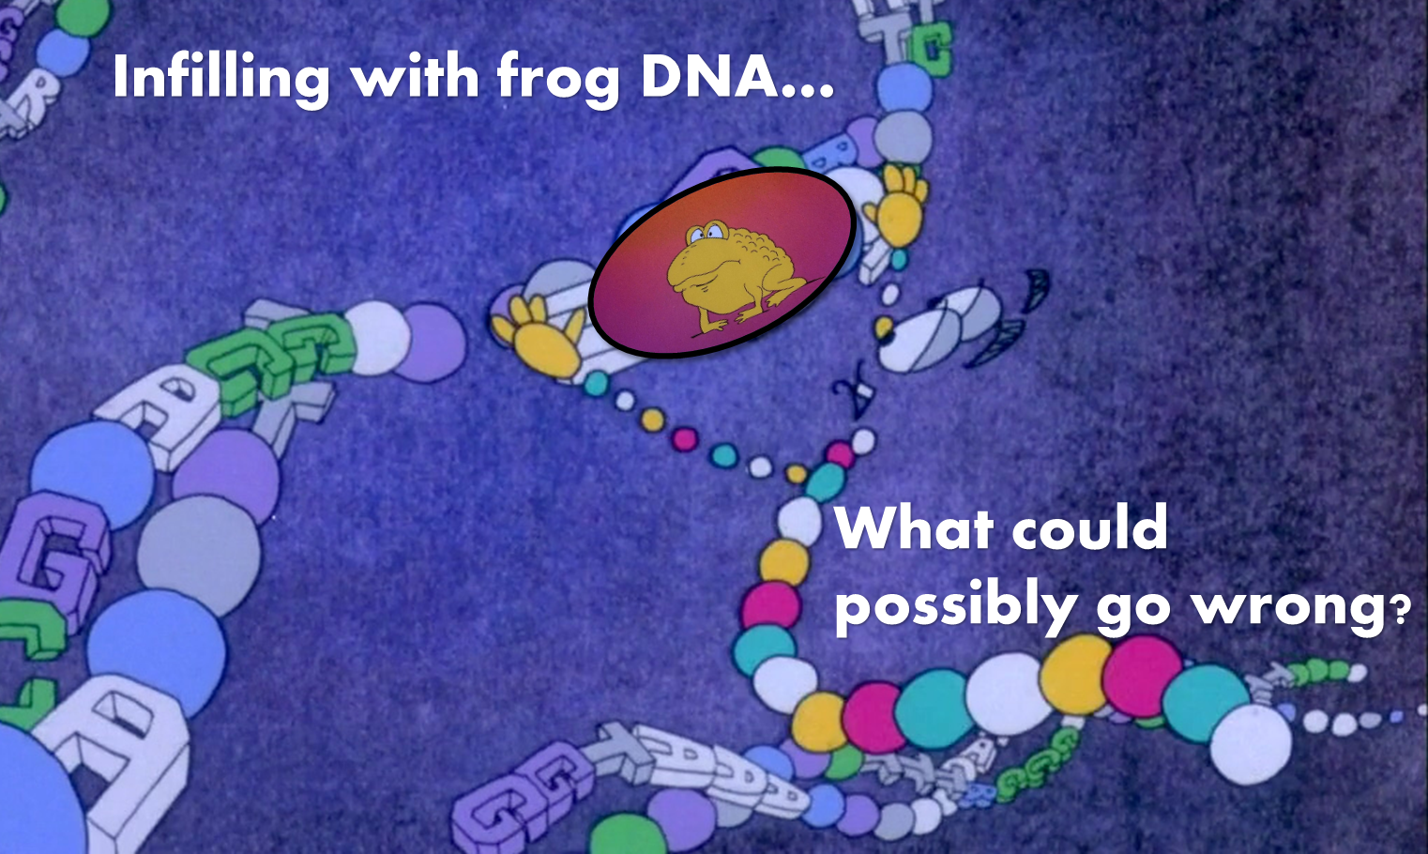
Integrating datasets with different time and geographical scales
Challenges related to missing data:
Potential for interpolation/imputation or Semi-Supervised Learning while maintaining transparency about missing data for trustworthiness;
Integrating patient lived experiences into Deep Learning and Incremental Learning models will help determine how well interpolation/imputation reflects reality;
Consider user-interface for choosing data smoothing/interpolation parameters:
(e.g., https://data.giss.nasa.gov/gistemp/maps/)

Slide 28
Integrating datasets with different time and geographical scales
Challenges related to scales:
Spatial: using citizen science to validate geospatial relationships;
Temporal: potential for statistical solutions e.g., interrupted time-series
Ensure transparency about how we have dealt with messiness at every step of the way for trustworthiness….

Slide 29
Thanks for listening!

